Slide 1



Energy Data Science A CAPSTONE PROJECT

Slide 2

Data analysis simplified
Demand for electricity increases every year. From 2003- 2013, electric prices of household increased by average of 72%, as the demand for energy increased.
Online data analysis is the process of managing, analyzing, visualizing and monitoring datasets from various sources to generate actionable insights.
In today’s fast-paced business world, smart data analysis tools are essential to successfully manage a business
Manage and visualize your metrics instantly, access your data anytime, anywhere, utilize full-service solutions, take charge of your outcomes

Slide 3
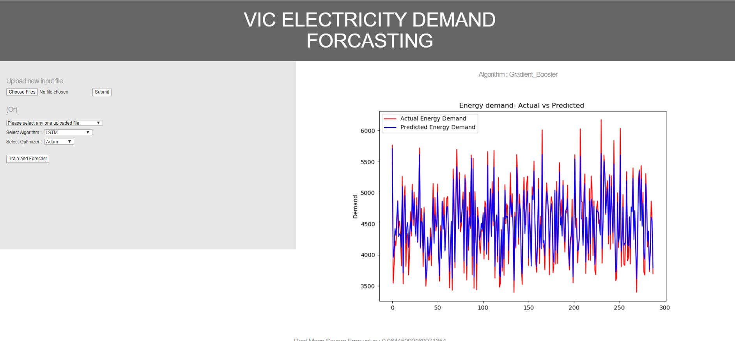
What is ENERGY DATA SCIENCE?
The application is a powerful web-based statistical application that is everything you need that brings statistics to life with real data.
It helps in predicting and forecasting the energy demand for data the user uploads.

Slide 4

Why is it developed?
The web application can help energy companies to know the energy demand in their states so that they can plan accordingly.
You can upload datasets to generate graphs, perform operation on data, do predictions, all using simple user interface.
Analyze and Visualize data
Fast Implementation
Easy to use.

Slide 5
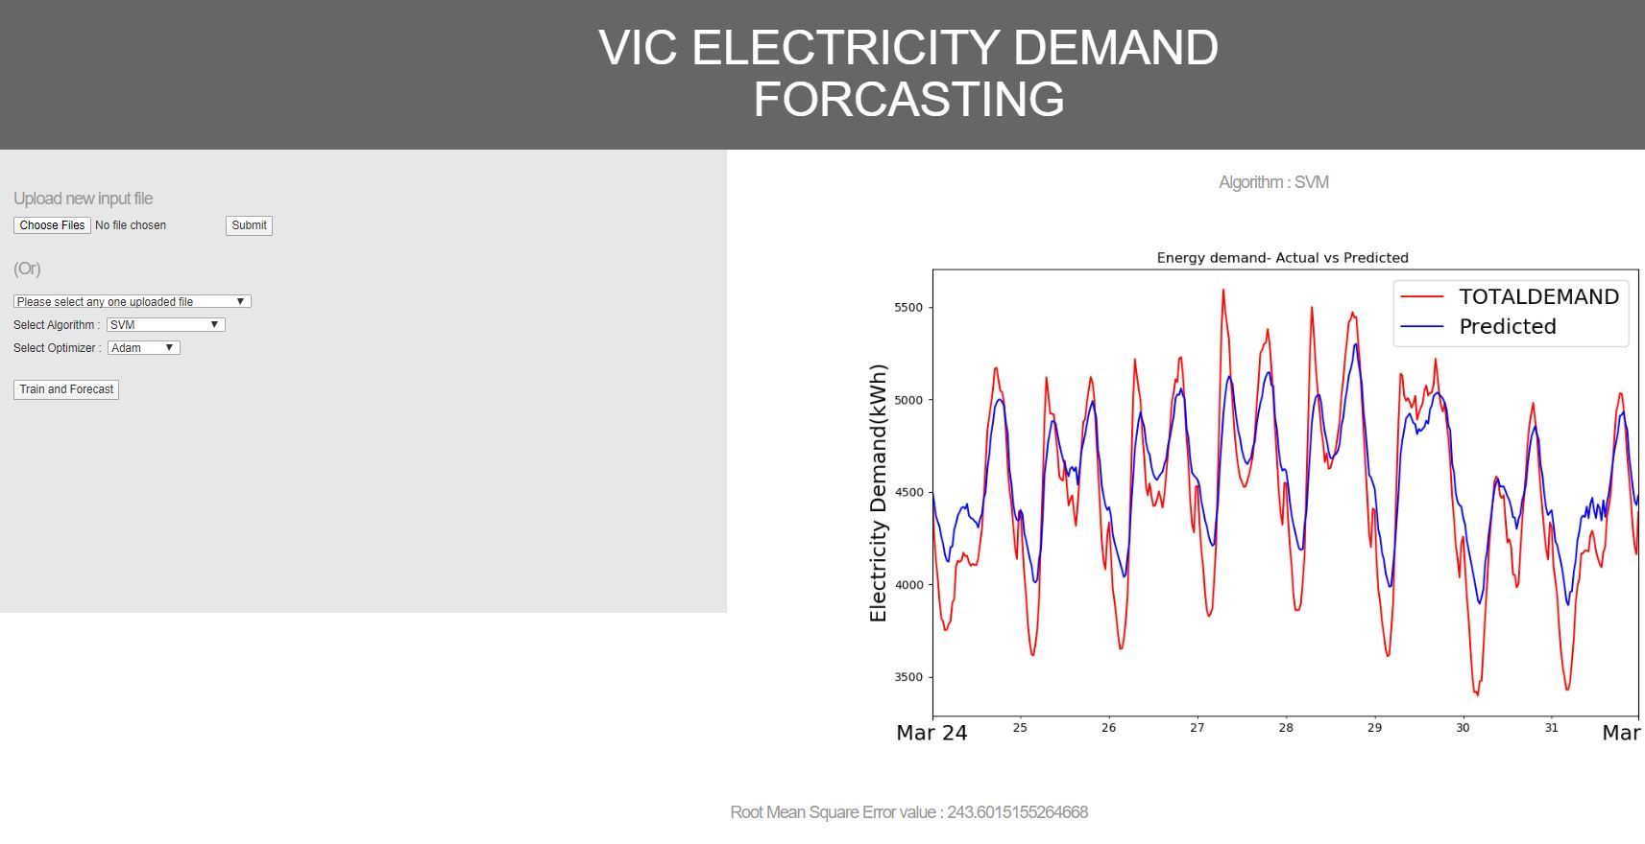
How it works?
The user can upload the data and choose any of the 4 algorithms LSTM, Support Vector Machine, Decision tree and Gradient Boost for analysis.
A Graph will be generated after the analysis which depicts the Original energy demand and predicted energy demand.

Slide 6

Future works?
The team is working on Multi-variate data analysis considering weather data such as temperature, humidity, rainfall.
The team will add dropdown to choose parameters for algorithms for better results.
The team will add options to choose the train test split for the data.
Finally, deploy the project on cloud.

Slide 7
Thank you

